Slide 1
Cultured/Cultivated Meat
By Alex
Notes:
Cultured, or cultivated, meat presentation by Alex

Slide 2
Overview
Title
Overview [this slide]
History pt. 1
History pt. 2
Plans and Implementation
Plans and Implementation (Visual)
Pros (environmental)
Pros (welfare)
Cons
Summary
Sources
Notes:
Overview slide

Slide 3
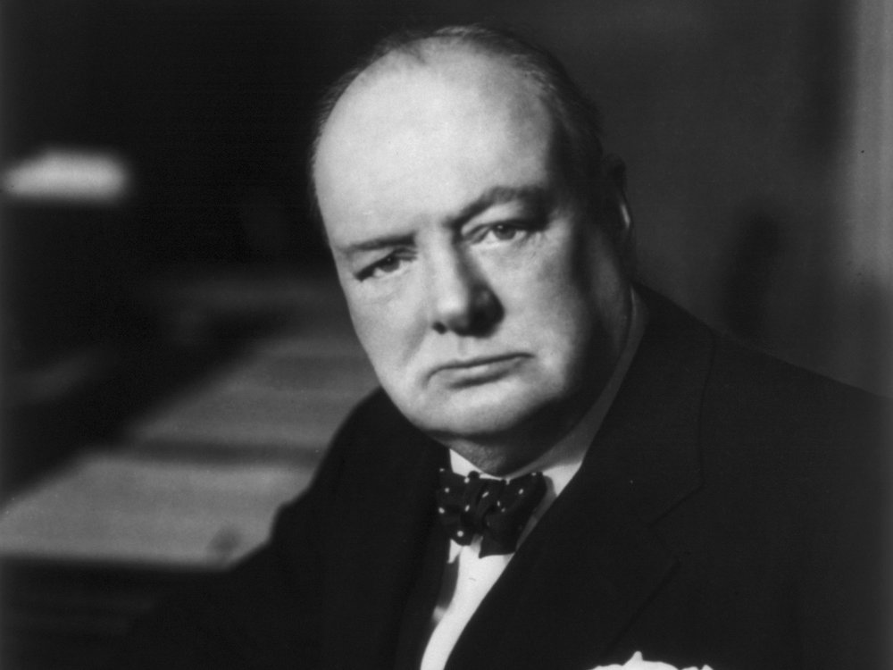
History pt. 1
Context: for decades, there’s been extensive cell research and culturing
Biotechnology dates to leavened bread from Ancient Egypt¹
1897: Sci-Fi novel Auf Zwei Planeten² first mentions the concept³
1931: Winston Churchill predicts cultured meat eight decades earlier:
“We shall escape the absurdity of growing a whole chicken in order to eat the breast or wing, by growing these parts separately under a suitable medium. Synthetic food will, of course, also be used in the future.” ⁴
Notes:
Cell research and culturing have been some of the most profound subjects in science for the last hundred years. Biotechnology itself (manipulation of biological processes for self gain) dates back to Ancient Egypt.
In 1897, German Sci-Fi novel Auf Zwei Planeten first suggested the concept of cultured meat.
And in 1931, Winston Churchill suggested that humans would develop cultured meat in the future.
1 “History of Biotechnology.” Lone Star College, LSC-Montgomery Biotechnology Department, n.d.
2 Swartz, Elliot, and Claire Bomkamp. “The science of cultivated meat.” Good Food Institute, n.d.
3 Lasswitz, Kurd. Auf Zwei Planeten. Southern Illinois University Press, translated 1971.
4 “No Bull.” International Churchill Society, Winston Churchill, 14 Jan. 2018.

Slide 4
History pt. 2
Late 1990s: Willem van Eelen files first cultured meat patent⁵
2013: Dutch scientist reveals the first cultured-meat burger on live TV
2 years later: the first four cultured meat burger companies emerge
Currently: there are more than 60 companies “...backed by $450M+ in investments…”⁵
Notes:
In the late 1990s, Willem van Eelen filed the first cultured meat process patent.
And in 2013, a Dutch scientists revealed the first cultured meat burger on live TV, blowing away viewers.
2 years later, the first four cultured meat burger companies emerged. Now, there are over 60 companies in the cultured meat industry, backed by 450 million in investments.
5 Hildreth, Cade. “The History of Cultured Meat and Where We’re at Today.” BioInformant, 13 Jan. 2023

Slide 5
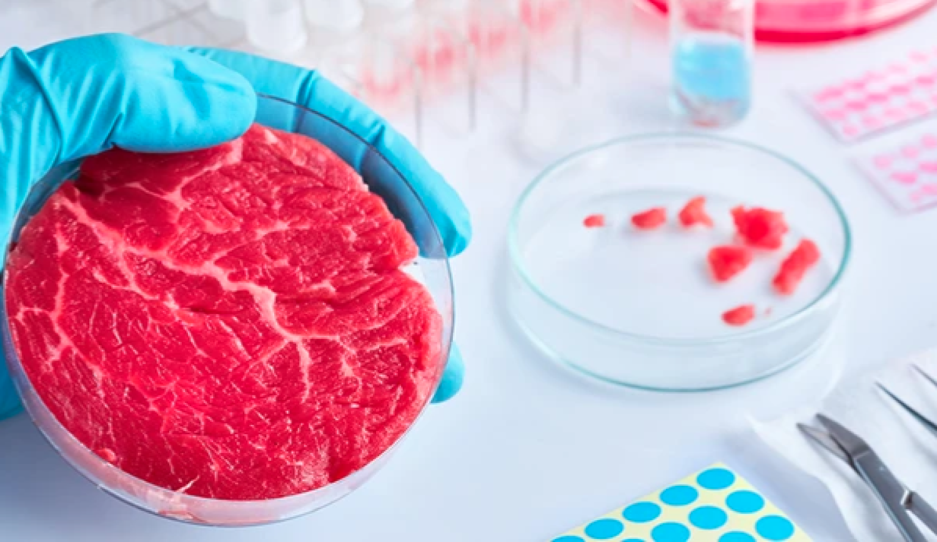
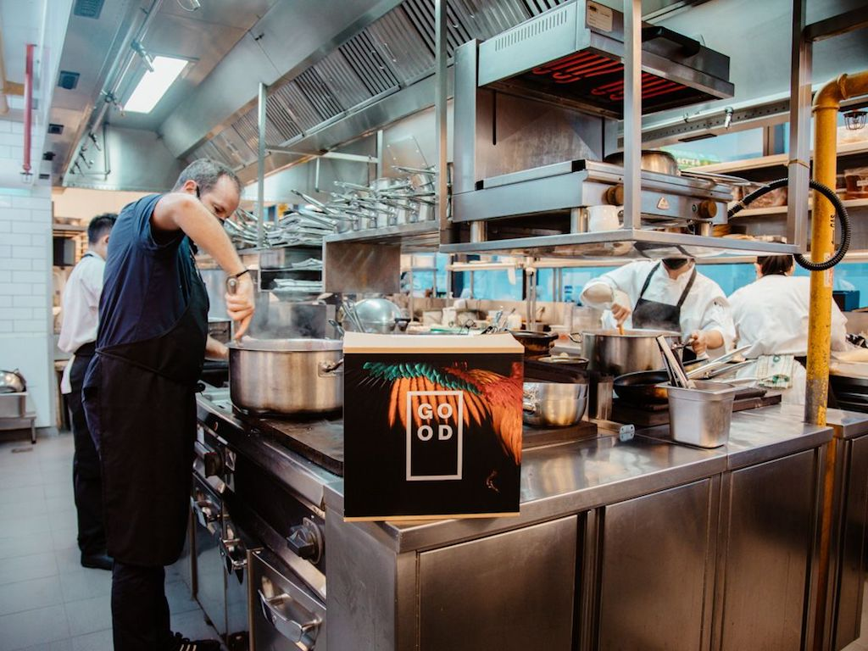
Plans and Implementation
The cultured meat industry is striving to entirely replace traditional mass meat production
U.S. start-up Eat Just has begun serving lab-grown chicken in a few restaurants in Singapore
The Singaporean Government approved the sales of the company’s lab-grown meat in late 2020⁶
Notes:
The cultured meat industry plans to replace traditional mass meat production entirely. U.S. start-up Eat Just began serving lab-grown chicken in 2020.
6 Scipioni, Jade. “This restaurant will be the first ever to serve lab-grown chicken (for $23).” CNBC, 18 Dec. 2020.

Slide 6
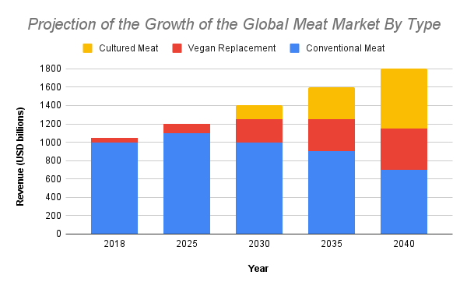
Plans and Implementation (Visual)
Notes:
The visual shows how three major meat market types are expected to grow over the next few decades

Slide 7

Pros (1): Environmental and Moral
Use significantly less land and water
Agriculture, specifically animal husbandry, is infamous for using lots of land and water
Reduce biodiversity loss, deforestation, greenhouse gas emissions, etc.
reduce “agriculture-related pollution and eutrophication”²
eutrophication: the process of exaggerated plant and algae growth in water habitats resulting from an overabundance of nutrient, usually from farm, industrial, and city runoff
leading to algae blooms, oxygen deficiencies, and fish and seagrass death
Cultured meat would eliminate dirty, tightly packed animal warehouses
Notes:
The pros of cultured meat include, using less land and water, reducing biodiversity loss and deforestation, producing less greenhouse gases, and reducing agriculture-related pollution and eutrophication.
Eutrophication is the process of water habitats–such as rivers, lakes, and coastal waters–becoming over exposed to nutrients, resulting in algae blooms, oxygen deficiencies, and the death of marine life.
Cultured meat would eliminate dirty, tightly packed animal warehouse, infamous for cruelty.

Slide 8
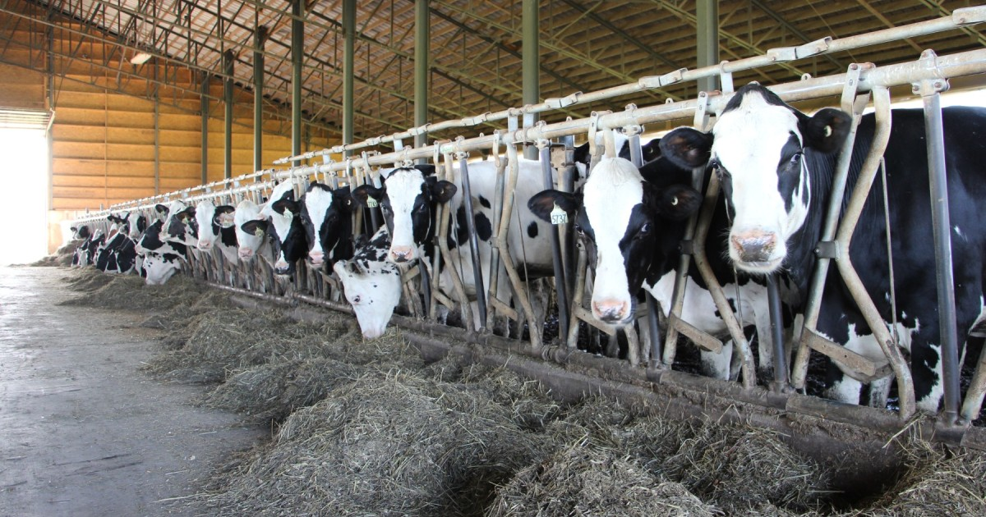
Pros (2): Welfare
Expected to entirely omit the use of antibiotics in livestock²
reduce the threat of antibiotic resistance in germs
reduced medication costs
Less exposure to pathogens meaning less foodborne illness in consumers
fewer incidents of zoonotic disease outbreaks
Grab a market share from the $1.7 trillion standard meat and seafood industry²
The increased efficiency of production and flexibility to produce cultivate anywhere would mean cheaper meat products
Meaning more people across the world would have access to healthy meat⁷
By 2030, cultured meat is expected to be price competitive with standard meat production²
Notes:
Cultured meat is expected to entirely omit the use of antibiotics in livestock, thus reducing the costs of medication and the threat of antibiotic resistance.
Cultured meat is constantly monitored and exposed to fewer pathogens, meaning less foodborne illness outbreaks.
The inherent efficiency of cultured meat would mean market competition with the $1.7 trillion standard meat and seafood industry
The image is of dairy cows (not for consumption).

Slide 9
Cons
Cultured meat is currently unable to compete with standard meat prices and comes at a premium
Cultured meat currently requires similar, if not more, energy to produce⁷
Notes:
Cultured meat is currently unable to compete with standard meat prices and comes at a premium
Cultured meat currently requires similar, if not more, energy to produce⁷
7

Slide 10
Summary
If cultured meat is able to reduce price and natural resource consumption from standard practices, it should entirely replace the standard meat industry.
There is zero possibility that people worldwide will give up meat; it is a fundamental part of the human diet. However, current animal husbandry is unsustainable. At the moment, cultured meat is the only viable long-term alternative for an increasing global population.

Slide 11
Sources
1 “History of Biotechnology.” Lone Star College, LSC-Montgomery Biotechnology Department, n.d.
2 Swartz, Elliot, and Claire Bomkamp. “The science of cultivated meat.” Good Food Institute, n.d.
3 Lasswitz, Kurd. Auf Zwei Planeten. Southern Illinois University Press, translated 1971.
4 “No Bull.” International Churchill Society, Winston Churchill, 14 Jan. 2018.
5 Hildreth, Cade. “The History of Cultured Meat and Where We’re at Today.” BioInformant, 13 Jan. 2023
6 Scipioni, Jade. “This restaurant will be the first ever to serve lab-grown chicken (for $23).” CNBC, 18 Dec. 2020.
7 Huddleston, Tom Jr. “How this 42-year-old CEO went from $3,000 in savings to creating a $1.2 billion food startup.” CNBC, 29 June 2022.

